Slide 1
ELEMENTARY STATISTICS, BLUMAN
Compare Standard Deviations
© 2019 McGraw-Hill Education. All rights reserved. Authorized only for instructor use in the classroom. No reproduction or further distribution permitted without the prior written consent of McGraw-Hill Education.

Slide 2
Objectives for this PowerPoint
Understand how variation in a data set affects the standard deviation
Compare the standard deviations of two similar populations

Slide 3
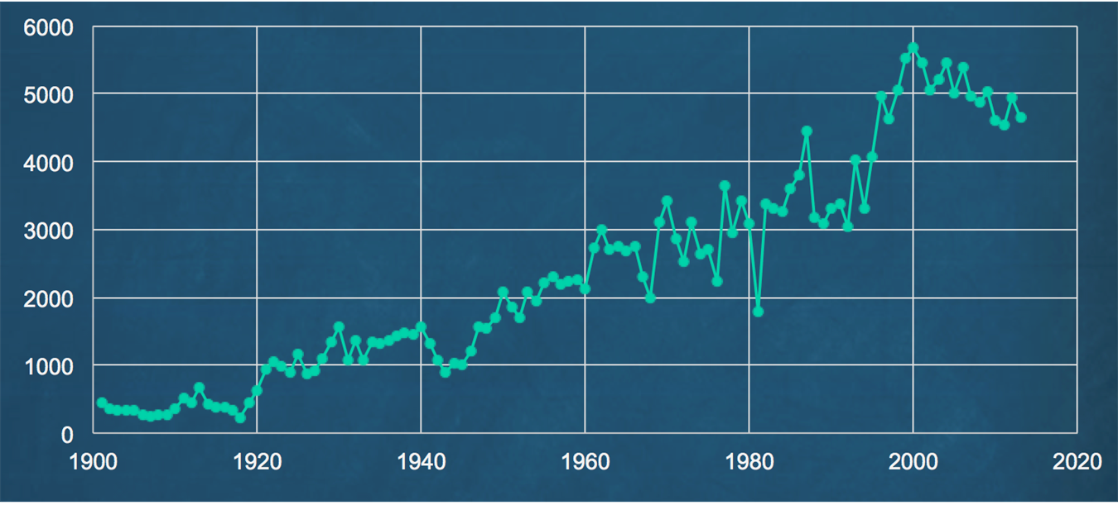
Major League Home Runs 1901 to 2013

Slide 4
Description of Time Series Graph
The time series graph on the previous slide shows the number of home runs hit in both major leagues from the 1901 to 2013 seasons.
If we were to describe what the graph tells us, we would probably note that there appears to be an upward trend in the data values.
But something else that is worth noting is that there appears to be an increase in variation in the data values, particularly once you get past the 1960 season.
So let’s separate the data into two populations. The seasons from 1901 to 1959 and the seasons from 1960 to 2013.

Slide 5
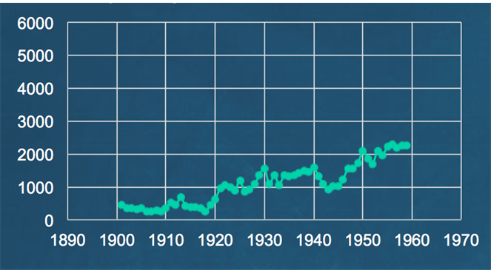
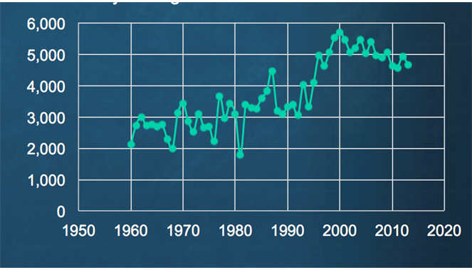
Major League Home Runs
1901 to 1959
1960 to 2013

Slide 6
Description of Data Sets
The data sets appear very different in the number of home runs and the variation from season to season. Much has been made of this increase and it’s contributing factors. Improvements in equipment and technique are considered contributing factors.
Also an increase in understand of the impact of nutrition and training on athletic performance and then the admitted abuse of performance enhancing drugs, especially in the 80’s, 90’s and 2000’s are believe to be reasons why the number of home runs hit per season is so much greater now.

Slide 7
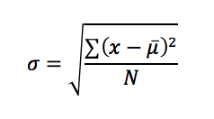
Formula for Standard Deviation
In order to quantify the variation in a data set, let’s recall the process for finding the standard deviation. Recall that the process for finding the standard deviation includes comparing each data value to the mean.

Slide 8
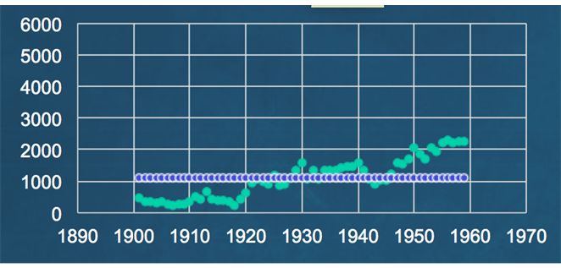
1901 to 1959 Home Runs
Here the mean of 1088.0 for the data set is plotted against the raw data values in the the time series graph for the 1901 to 1959 seasons.

Slide 9
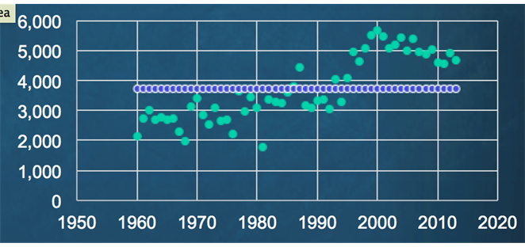
1960 to 2013 Home Runs
The mean of 3721.0 is higher for the 1960 to 2013 seasons.
But notice also that the individual data values tend to stray farther from the mean.

Slide 10
Standard Deviation (1)
To find the standard deviation you subtract the mean from the data value and then square. These values are then all added together. So the larger these differences between the mean and the individual data values the larger the variance. Therefore the standard deviation will be larger.
Due to the greater variation between each data value in the mean, we would expect the standard deviation for the 1960 to 2013 seasons to be greater than that for the 1901 to 1959 seasons.

Slide 11
Standard Deviation (2)
The standard deviation for the 1901 to 1959 seasons is 621.7.
The standard deviation for the 1960 to 2013 seasons is 1075.0.
So if we did not have the graphs in front of us, but were instead provided with only the standard deviations for these two similar populations, we would gather from the standard deviations that there is more variation in the number of home runs in the 1960 to 2013 season then in the 1901 to 1950 seasons.

Slide 12
Summary
In this PowerPoint we learned that variation in a data set affects the standard deviation. We also compared the standard deviations of two similar populations.

